Slide 1
Jerry Space windmills https://editor.p5js.org/Jerry-812/sketches/0ZU7zSW4f Evolution process of universe Instructions Click on the mouse to explore In this sketch, i used the image of windmills to simulate the process of the Big Bang.

Slide 2
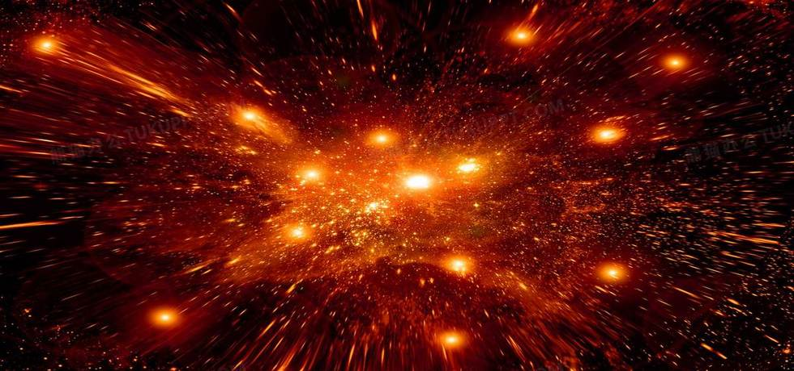
Abstract
The Big Bang event is a physical theory that describes how the universe expanded from an initial state of high density and temperature.

Slide 3



Abstract

Slide 4
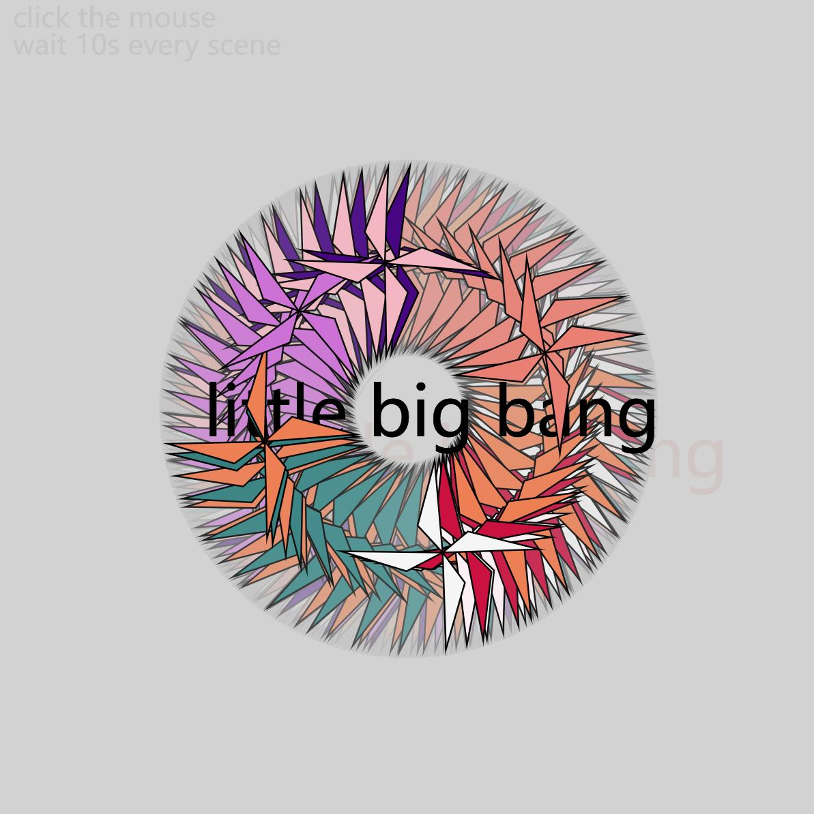
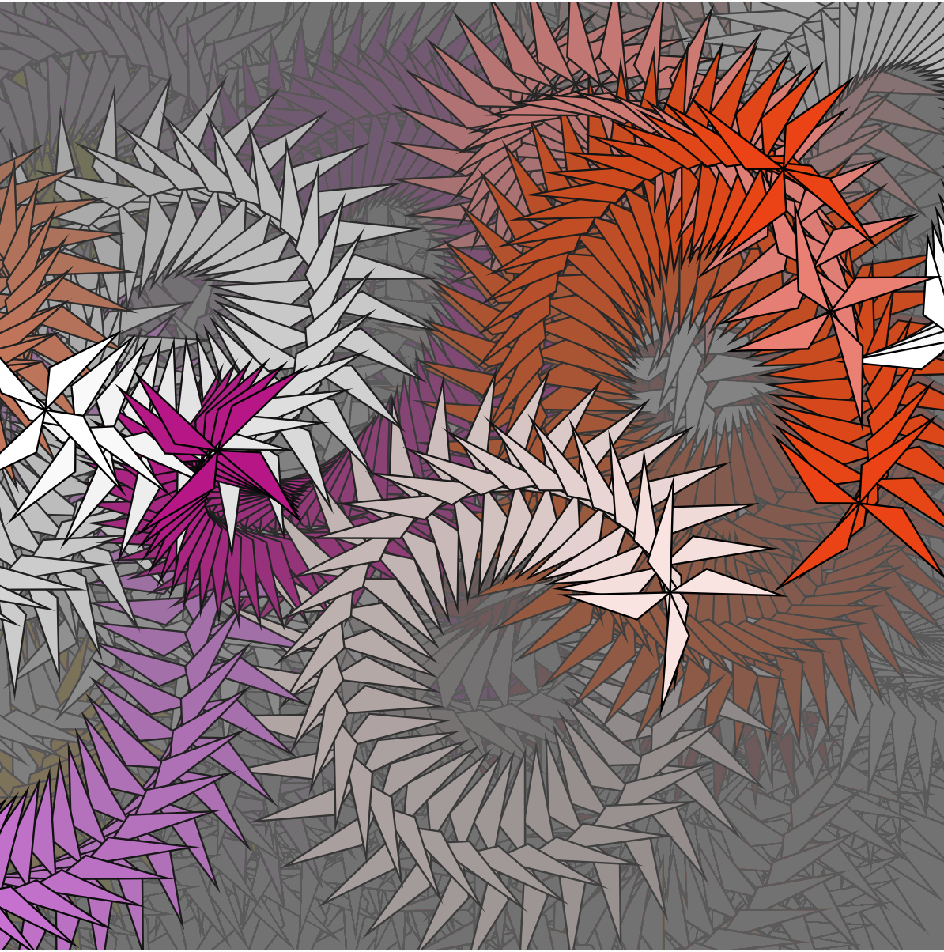
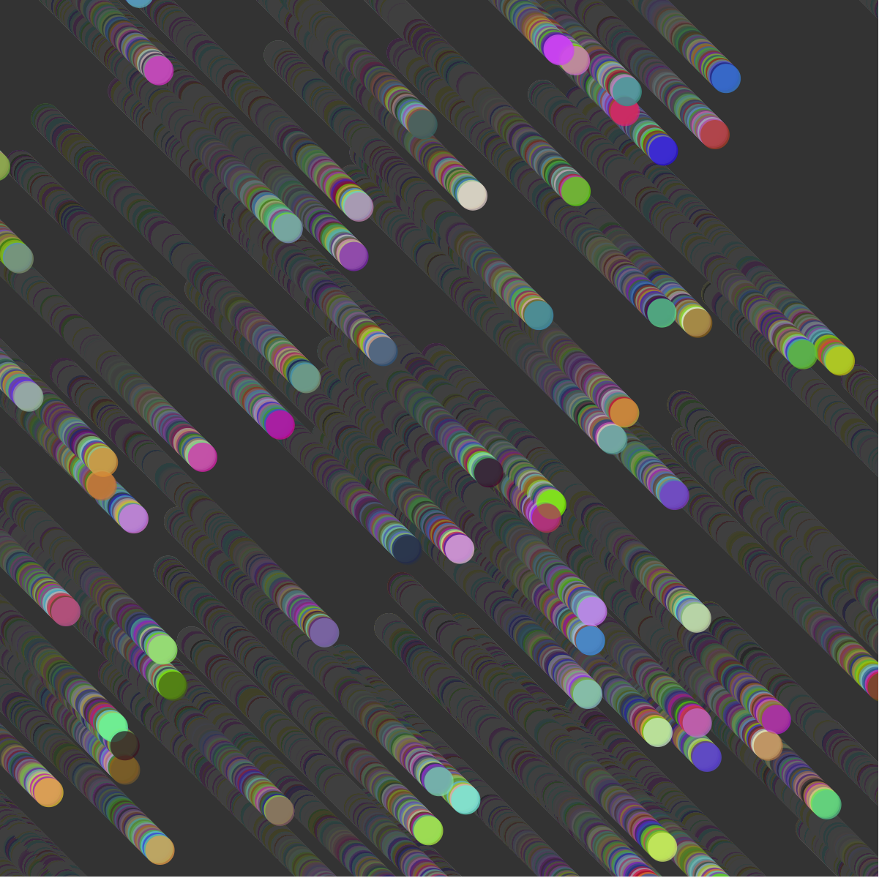
Images
the instant of the bombing
the targeting of galaxies
the meteors

Slide 5
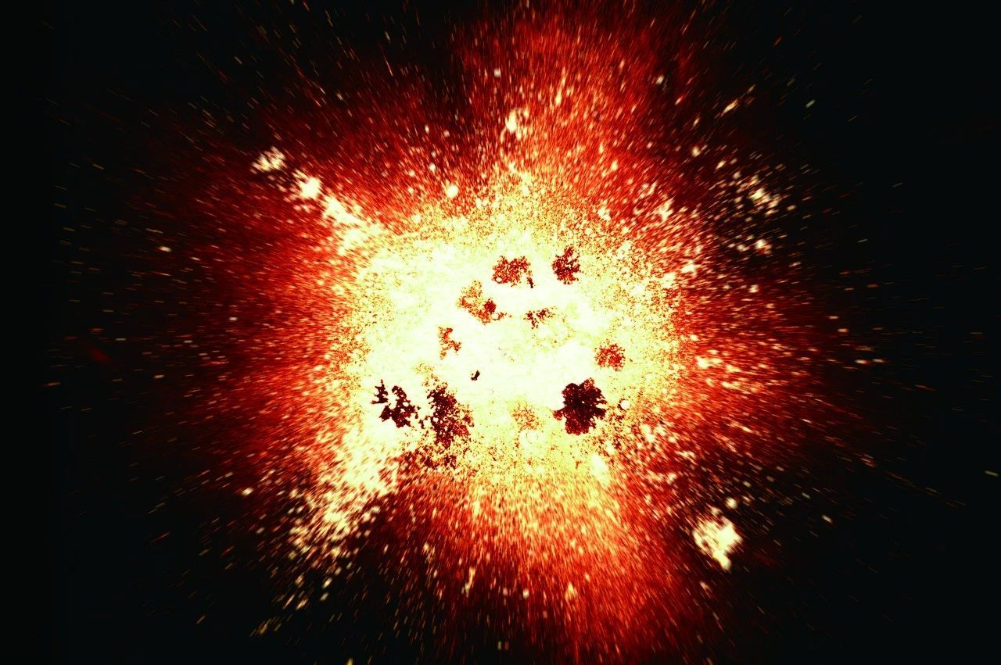
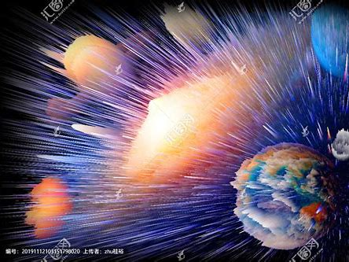
Design and Composition
When I think about the design, I try to follow the steps of the Big Bang.

